Slide 1

Colab Traning

Slide 2
Review
git commit
git push
pull request

Slide 3

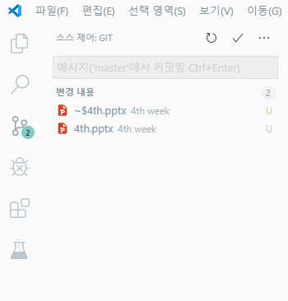
Review
git commit
git push
pull request

Slide 4

Review
git commit
git push
pull request

Slide 5
Review
git commit
git push
pull request

